Slide 1
Data Structure and Algorithms
Azaz Ahmed Kiani

Slide 2
Double Ended Queue Lesson 17
2

Slide 3
Queue
Deletion (Dequeue) can take place only at one end, called the front
Insertion (Enqueue) can take place only at the other end, called the rear
The general Queue model is
Queue Q
Dequeue( ) Enqueue (x)
3

Slide 4
Graphic Model of Queue
Rear:
All new items
are added on
this end
Head:
All items are
deleted from
this end

Slide 5
Double Ended Queue
5

Slide 6
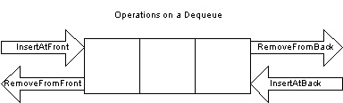
Deque – Double Ended Queue
Deque or Double Ended Queue is a type of queue in which insertion and removal of elements can either be performed from the front or the rear.

Slide 7
Deque – Double Ended Queue
Thus, it does not follow FIFO rule (First In First Out)

Slide 8
Deque – Double Ended Queue
Elements can only be added or removed from front and back of the queue
Typical operations include
Insert at front an element
Insert at back an element
Remove from back an element
Remove from front an element

Slide 9
Double Ended Queue (Operations)
9

Slide 10
Insert Elements at REAR
we check if the queue is full. If its not full we insert an element at rear
If the queue is empty then intialize front and rear to 0. Both will point to the first element.
Else we increment rear and insert the element.

Slide 11
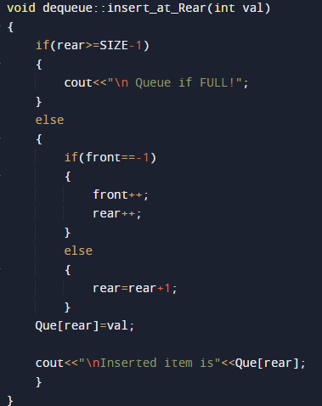
Insert Elements at REAR (CODE)

Slide 12
Insert Elements at Front
First we check if the queue is full. If its not full we insert an element at front end by following the given conditions :
If the queue is empty then intialize front and rear to 0. Both will point to the first element.
Else we decrement front and insert the element.

Slide 13
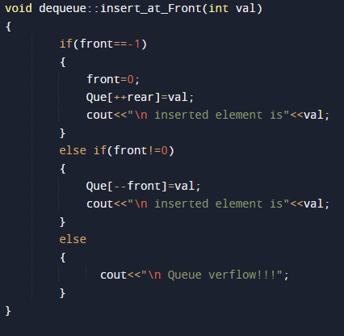
Insert Elements at Front (Code)

Slide 14
Delete From Front
In order to do this, we first check if the queue is empty.
If its not then delete the front element by following the given conditions :
If only one element is present we once again make front and rear equal to -1.
Else we increment front.

Slide 15
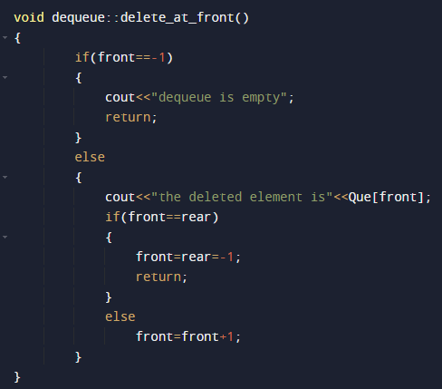
Delete From Front (Code)

Slide 16
Delete From Rear
Inorder to do this, we again first check if the queue is empty.
If its not then we delete the last element by following the given conditions :
If only one element is present we make front and rear equal to -1.
Else we decrement rear.

Slide 17
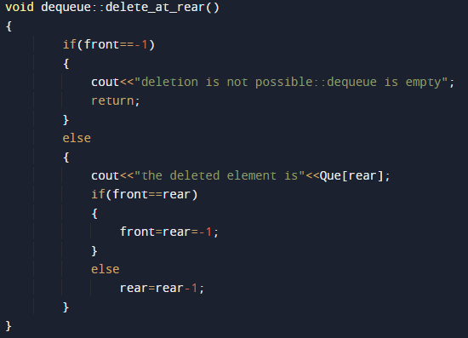
Delete From Rear (Code)

Slide 18
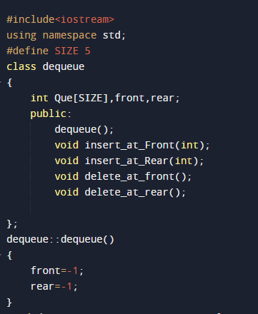
Complete Code

Slide 19
Complete Code

Slide 20
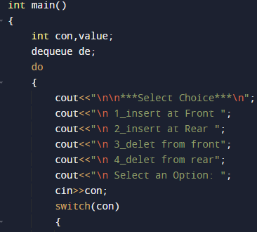
Complete Code

Slide 21
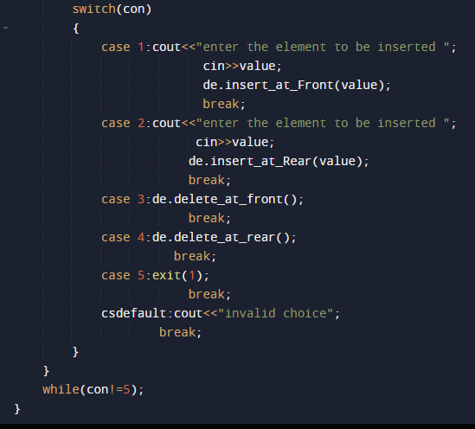
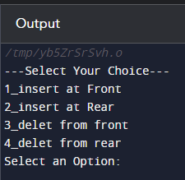
Complete Code

Slide 22
Queue Applications
Operating system
multi-user/multitasking environments, where several users or task may be requesting the same resource simultaneously.
Communication Software
queues to hold information received over networks and dial up connections. (Information can be transmitted faster than it can be processed, so is placed in a queue waiting to be processed)
Simulation
Print Queue

Slide 23
Summary…!
23

